Slide 1



ADVANCE INDICATOR FOR VEHICLES TO AVOID road ACCIDENTS
K S R INSTITUTE FOR ENGINEERING AND TECHNOLOGY
Tiruchengode, Namakkal – 637 215
Approved by AICTE, New Delhi and Affiliated to Anna University, Chennai
Accredited by NAAC (‘A+’ Grade) & NBA (UG – CSE, EEE, ECE, IT & MECH)
B. S. Ranjith
IV – YEAR
B.Tech. Information Technology

Slide 2
CONTENTS
Existing Model:
Limitations:
Survey
Proposal Model:
Case: 1
Case: 2
Case: 3
Sensors

Slide 3
Existing Model:
Manual mode is operated by the individual whose is riding the bike. The rider can turn on/off the bike indicators whenever the rider needs to turn on/off (depends up on the situation).
The bike riders have to use the indicators to inform other road users when they intend to change the direction.
To use the bike indicators in right time, have to give the plenty of time to other road users to react and adapt to the signal.
Once the turn is completed make sure the indicators are cancelled otherwise it may confuse other road users.

Slide 4
Limitations of the Manual Mode
• Confusing the other road users by not turning on the bike indicators in the right time and vice versa.
• Riders are forgot to turn off the indicator in the right time.
• Number of accidents are increased.

Slide 5


Slide 6
Literature Survey
Sl no | Title | Author | year
1 | Automatic Vehicle Turn Indicator Using Speech Recognition | Akshay Divakar, Sitaraa Krishnakumar | September 2019
2 | Automatic Turning ON/OFF Bike indicator using GPS Navigation System | S Usha, Kathik Murugean, R Lalitha, Jothibasu Marappan | February 2021

Slide 7
Proposal Model:
In order to overcome these types of difficulties, an automatic turning off bike indicators is proposed. . Let's discuss this in detail with 3 cases.

Slide 8
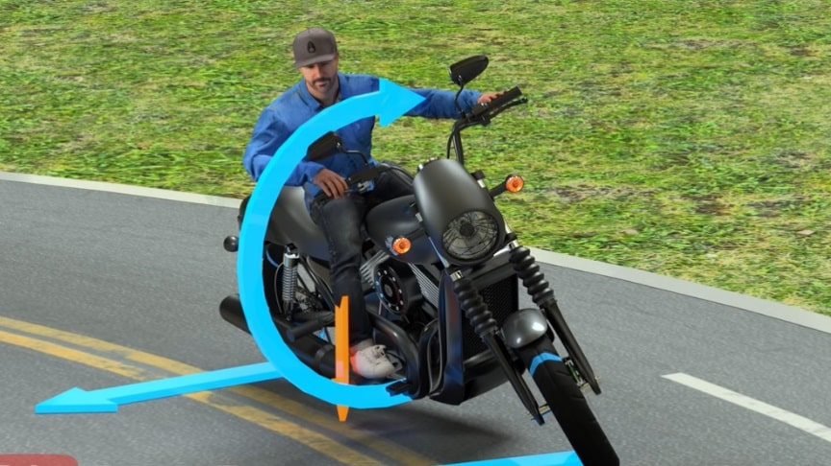
Case: 1
This case is applicable for the two wheelers. Till today while driving, people are turning on/off the indicators manually. The bike riders forgot to use the indicators in the right time. This resulted in many accidents.
As per my project, let's fix this problem "BIKE INDICATOR" which works AUTOMATICALLY.
This indicator will sense the angle of the handlebar in bike and navigates automatically by doing the work of indication.
Manually rider have to turn on the indicator but the indicator will turn off automatically. This sensor will sense the angle and turns off automatically once the turning angle retains to normal angle.
It will be turning off automatically after crossing (approx."15 meters) of indication. This will result with a safety ride.
User can also turn off manually(if need)

Slide 9
Case: 2
While starting ride for an urgent work most of the people fails to check whether indicator is in on or off. In some cases, indicator of the bike which is in rest may turn on. Person who is going to start the same bike again may fail to check the indicator.
As a solution our will turn off the indicator automatically once the bike gets started. This is will sure help the person to avoid terrific accidents.
Emergency works could be easily done here after without the pressure of checking indicators.

Slide 10
Case: 3
This is applicable for all vehicles. At highways most of vehicles like lorry, trucks even cars fail to turn off the indicators. Often those indicators are turned ' on ' especially travelling on highway roads. This may result in heavy accidents.
As per our project, in this case when a vehicle's steering or handle bar is in same position continuously moving for (approx. 200 meters) this indicator will be turned off automatically.
Our "AUTOMATIC INDICATOR TURN OFF" will sense the travelling distance and position of the steering or handle bar.

Slide 11
SENSORS
ACCELEROMETER
GYROSCOPE
Accelerometers measure linear acceleration (specified in mV/g) along one or several axis.
MOVEMENT is measured.
For e.g. Maps
A gyroscope measures angular velocity (specified in mV/deg/s)
ROTATION is measured.
For e.g. Compass
‘A’ + ‘G’ = BOTH MOVEMENT AND ROTATION IS POSSIBLE

Slide 13
Questions???

